Slide 1
JavaScript Local Storage API
Storing and Retrieving Simple Data,
Arrays, Associative Arrays,
and Objects

Slide 2
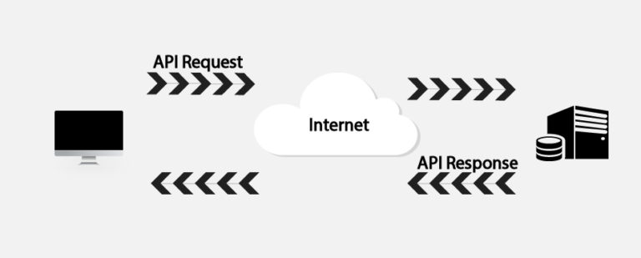
API: Application Programming Interface
Application Programming Interface (API) in its simplest form is code that allows for two software programs to communicate with each other. APIs within a program are a set of standards which permit outside software systems to request information from the original program. Josh Walker, an analyst at Forrester Research, describes building an application with no APIs as “basically like building a house with no doors. The API for all computing purposes is how you open the blinds and the doors and exchange information.”

Slide 3
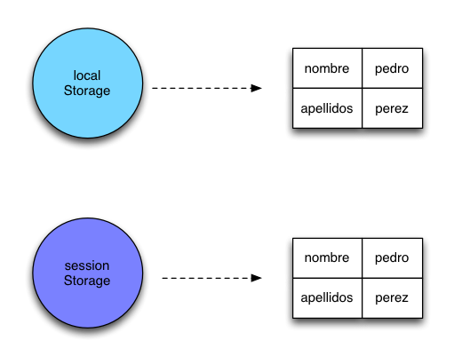
Types of Storage
There are 2 main types of Storage, both work the same, but one can store data beyond the current application usage.
First
Last
John
Doe
First
Last
John
Doe

Slide 4
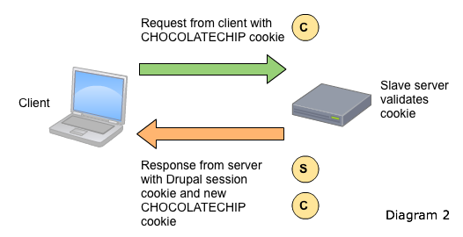
More about Storage
Session/Local Storage can’t be over 5MB (5,000,000 characters)
(Point of Reference, 29 page, 32K Character paper = 40KB)
Cookies are additional storage by websites beyond that capacity and are similar to Session Storage. Not as flexible as local storage.

Slide 5
Let’s Look at Code!

Slide 6
Storing data in Local Storage*
Consider the array:
var movies = [“Harry Potter", “Zoolander", “The Count of Monte Cristo”, “Inception", “Lord of the Rings"];
Can be stored in this way:
localStorage.setItem(“StoredSlotName", JSON.stringify(movies));
Or in other ways:
localStorage.setItem(“CurrentMovie”, “Zoolander”);
*sessionStorage / localStorage can be used in the exact same way, but the examples are using localStorage for simplicity

Slide 7
Retrieving Data
Pull the entire string:
Var listMovies = localStorage.getItem(“StoredSlotName");
console.log(listMovies); // will print out ‘listMovies’ string
Or, if we want to pull ‘CurrentMovie”:
Var currentMovie = localStorage.getItem(“CurrentMovie");
Displaying what we retrieved:
console.log(CurrentMovie); // will print out ‘Zoolander’

Slide 8
Removing Data
Delete everything in storage (often called ‘scorched earth’ approach) as it will remove all traces of any data you may have stored
localStorage.clear();
To delete only certain parts of our local storage, we can be more specific if we need to be:
localStorage.removeItem("CurrentMovie");
This clears BOTH CurrentMovie, AND it’s value (Zoolander). If you simply want to clear the value and keep the key initialized, you are better off doing this:
localStorage.setItem(“CurrentMovie”, “”);

Slide 9
HTML/JavaScript DOM Manipulation
Using createElement,
appendChild,
insertBefore,
removeChild, etc.

Slide 10
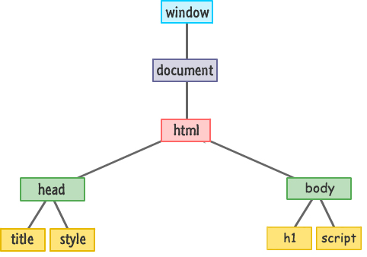
What is a DOM?
DOM stands for Document Object Model.
The Document Object Model is the order in which objects appear on a layout. Obviously it can be much more complicated, but this is a general structure for our purposes

Slide 11
What is DOM Manipulation?
This boils down to one basic idea, that the DOM can be changed with JavaScript.
You can add to it using createElement and append to any existing element
You can remove items by using removeChild (even default ones)
You can clone elements, reorder elements, basically reorganize the DOM in any way you see fit and for whatever reason you might wish.

Slide 12
So again, Let’s Look at Code!

Slide 13
Creating Elements
It’s easy to create elements, all you need to do is something like this in JavaScript:
document.createElement(“theFifth”);
However, “theFifth” element does not exist on our layout, we need to add it somewhere
<script>
var newElement = document.createElement(“theFifth”);
newElement.textContent = “My name is a pun”;
document.body.appendChild(newElement);
</script>
This places our new element at the bottom of the Body element.

Slide 14
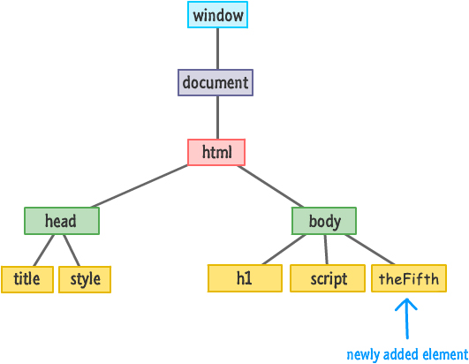
Let’s see how that looks

Slide 15
Removing Elements
Just as it is easy to add elements, it’s just as easy to remove them. To remove “theFifth” we simply need to do the following
document.body.removeChild(newElement);
You may notice that we used the variable name from our create element script rather than the element name, this is something worth remembering.
Again, you can use this to remove objects that are native to the layout such as h1 etc.
By removing an object, it also removes all of it’s children. For example, removing a <div> element removes everything contained in the <div>.

Slide 16
Cloning Elements
What if we wanted to clone an element? This is a bit more complicated, but not by much. It requires a little extra explanation. Let’s start by looking at this code:
<div id="footer">
<div class="share">
<p>Something</p>
<img alt="#" src="blah.png"/>
</div>
</div>
<script>
var share = document.querySelector(".share");
var shareClone = share.cloneNode(false); // False means only clone this
document.querySelector("#footer").appendChild(shareClone);
</script>

Slide 17
Cloning Elements Ctd
It should look something like this if done correctly. Note, these changes don’t modify the original code.
<div id="footer">
<div class="share">
<p>Something</p>
<img alt="#" src="blah.png"/>
</div>
<div class="shareClone">
<p>Something</p>
<img alt="#" src="blah.png"/>
</div>
</div>

Slide 18
AppendChild
Looking at this code again, we notice that the cloned element was added, or appended, to the footer using appendChild. Its uses are not limited to cloning, but otherwise is pretty self explanatory.
<div id="footer">
<div class="share">
<p>Something</p>
<img alt="#" src="blah.png"/>
</div>
</div>
<script>
var share = document.querySelector(".share");
var shareClone = share.cloneNode(false); // False means only clone this
document.querySelector("#footer").appendChild(shareClone);
</script>

Slide 19
insertBefore
The native function of insertBefore will allow you to move an element to anywhere you think might look best within the same parent. For example, if I wanted “theFifth” element to be placed before the heading, I would use the following code:
<body>
<h1 id="theTitle" class="highlight Movies">Movie Mondays!</h1>
<script>
var newElement = document.createElement(“theFifth”);
newElement.textContent = “My name is a pun”;
var h1Element = document.querySelector(“h1”);
document.body.insertBefore(newElement, h1Element);
</script>
</body>

Slide 20
insertAfter
There are times when you want something to be after something, or at the end of something. If we wished to do this with insertBefore, it might look like this:
var h1Element = document.querySelector("h1");
document.body.insertBefore(newElement, h1Element.nextSibling);
This would place newElement (“theFifth”) after our heading, rather than before it.
As there is no native function for insertAfter, if we need one we can make our own without too much difficulty using something like this:
function insertAfter(target, newElement) {
target.parentNode.insertBefore(newElement, target.nextSibling);
}

Slide 21
The End

Slide 22
Great Resources
Storing Data Using Web Storage
Storing and Retrieving an Array from Local Storage
Creating DOM Elements...and Other Related Stuff!

